Slide 1
Ramping HMI screens
Jan. 4 2018
Suggested edits - TR

Slide 2
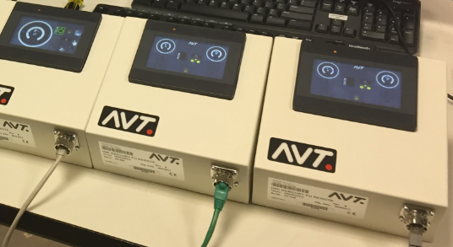
Press side controls
Pictured here with enclosure
Notes:
HMI display/touchscreen option for the operator sweep/water controls of the AVT PLC.
4in x 3in color LCD display, touchscreen face.
Finger or stylus operates touchscreen.
Protective cover on display face.
LED power indicator on the face of display.
Mounting on rear can be left or right side.
POE Ethernet supplies data comm and power to enclosure.

Slide 3
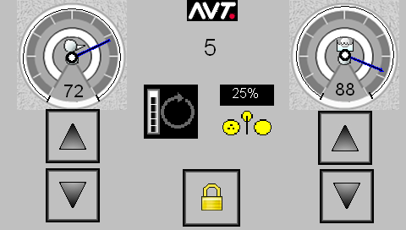
Home screen
Main operator view
Button is hard to select.
Can we remove this background or make the entire background the same texture? I can provide new artwork.
Button is missing border.
Line up buttons
Center all elements within screen area.
Notes:
Main working screen for the AVT Mercury Press Side Controls:
Left dial is the Ink Sweep Trim setting control.
Right dial is the Water Dampening Trim setting control.
Increase/decrease arrows for each dial, 1 percent change for each tap.
There is no auto repeat like Mercury Client when buttons are held down.
Both dials:
a. Tapping on the upper half of the dial will switch to the zoomed view of that control.
b. Tapping on the digits will show a onscreen keypad to enter the desired value of dial.
After any change to dial, the RUN control will light up.
RUN control button on left center will change the PLC when lit, then go off when completed. There is only one status indicator on dials, current value on the PLC. There is no console setting like Mercury Client. Any change on the dials will require the RUN to be tapped to execute to the PLC.
Inker Ductor control button on center right will change when tapped. It will cycle through all choices. The current value is displayed inside the control. RUN is not required to be tapped to change the PLC.
Fountain ID digit at upper center.
AVT logo will switch to HMI configuration view.
The Lock button at lower center will switch to LOCKED view.

Slide 4
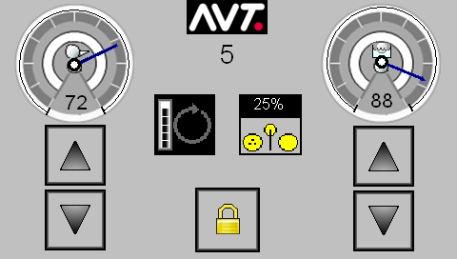
Home screen (with suggested revisions)
Main operator view
Button is increased to 85 pixels wide.
Notes:
Main working screen for the AVT Mercury Press Side Controls:
Left dial is the Ink Sweep Trim setting control.
Right dial is the Water Dampening Trim setting control.
Increase/decrease arrows for each dial, 1 percent change for each tap.
There is no auto repeat like Mercury Client when buttons are held down.
Both dials:
a. Tapping on the upper half of the dial will switch to the zoomed view of that control.
b. Tapping on the digits will show a onscreen keypad to enter the desired value of dial.
After any change to dial, the RUN control will light up.
RUN control button on left center will change the PLC when lit, then go off when completed. There is only one status indicator on dials, current value on the PLC. There is no console setting like Mercury Client. Any change on the dials will require the RUN to be tapped to execute to the PLC.
Inker Ductor control button on center right will change when tapped. It will cycle through all choices. The current value is displayed inside the control. RUN is not required to be tapped to change the PLC.
Fountain ID digit at upper center.
AVT logo will switch to HMI configuration view.
The Lock button at lower center will switch to LOCKED view.

Slide 5
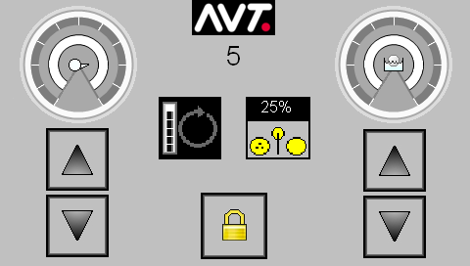
Home screen (with refined, blank dials)
Main operator view
Cleaned up dials are 130 x 130 pixels with matching background to screen.
Notes:
Main working screen for the AVT Mercury Press Side Controls:
Left dial is the Ink Sweep Trim setting control.
Right dial is the Water Dampening Trim setting control.
Increase/decrease arrows for each dial, 1 percent change for each tap.
There is no auto repeat like Mercury Client when buttons are held down.
Both dials:
a. Tapping on the upper half of the dial will switch to the zoomed view of that control.
b. Tapping on the digits will show a onscreen keypad to enter the desired value of dial.
After any change to dial, the RUN control will light up.
RUN control button on left center will change the PLC when lit, then go off when completed. There is only one status indicator on dials, current value on the PLC. There is no console setting like Mercury Client. Any change on the dials will require the RUN to be tapped to execute to the PLC.
Inker Ductor control button on center right will change when tapped. It will cycle through all choices. The current value is displayed inside the control. RUN is not required to be tapped to change the PLC.
Fountain ID digit at upper center.
AVT logo will switch to HMI configuration view.
The Lock button at lower center will switch to LOCKED view.

Slide 6
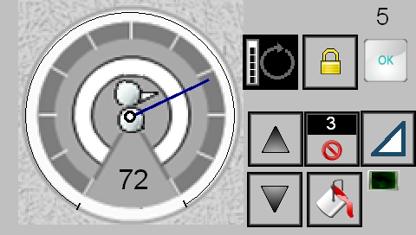
Sweep zoomed
Tap on sweep dial on main screen and you get this view.
Button is odd size. Seems out of place.
Can we remove this background or make the entire background the same texture?
Line up buttons. We have odd spacings going on here.
Can we reduce the overall size of this dial to make more room for the buttons on the right?
Button is odd size. Seems out of place. Icon does not make it clear of button function. Replace with wash bucket?
Center all elements within screen area.
Notes:
Inker sweep controls, minus the ductor control.
1st row: digit in corner is fountain number.
2nd row: RUN control to confirm changes, lock control, OK returns to main view.
3rd row: trim increase, surge timer and cancel, inker function status.
4th row: trim decrease, surge timer increase, wash up status (green when wash up state is on)

Slide 7

Sweep zoomed (with suggested revisions)
Tap on sweep dial on main screen and you get this view.
Cleaned up dials are 199 x 199 pixels with matching background to screen.
Notes:
Inker sweep controls, minus the ductor control.
1st row: digit in corner is fountain number.
2nd row: RUN control to confirm changes, lock control, OK returns to main view.
3rd row: trim increase, surge timer and cancel, inker function status.
4th row: trim decrease, surge timer increase, wash up status (green when wash up state is on)

Slide 8
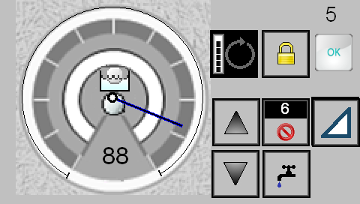
Water zoomed
Tap on sweep dial on main screen and you get this view.
Same critiques as the sweep screen… centering, button alignment / sizes, decrease dial size, background, etc.
Notes:
Water controls
1st row: digit in corner is fountain number.
2nd row: RUN control to confirm changes, lock control, OK returns to main view.
3rd row: trim increase, flood timer and cancel, inker function status.
4th row: trim decrease, flood timer increase

Slide 9
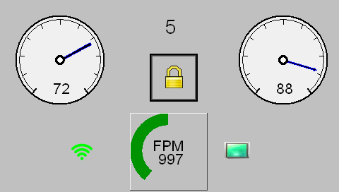

Lock view
Tap on the lock button and changeable controls are removed.
Center up elements
Should we make this the same red dot as used on the Client GUI?
Remove speed indicator completely and replace with 64x64 pixel Ardagh logo.
Notes:
Screen shows the current status of ink sweep and water controls. No changeable controls on this screen.
Also shown is :
PLC connection state (green waves for connected, red waves for disconnected)
Current Press speed dial and FPM data.
Current Press ON Impression state (bright green for ON Impression, Dark Green for OFF impression)
Press the LOCK control to exit this view.

Slide 10
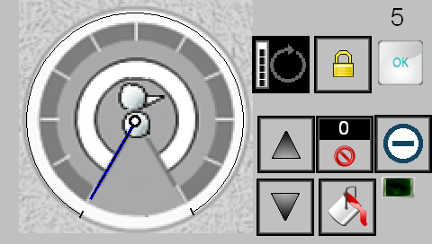
Sweep OFF
Sweep function setting is switched to OFF
Not sure how to activate wash from this state. Can the lower right button be a wash bucket and act as a toggle on/off for wash?
Notes:
The inker function mode is OFF – no sweep output, ductor is 0%, no inker trim setting nor surge operation is possible.

Slide 11



Sweep OFF (w/ suggested edits-wash active)
Sweep function setting is switched to OFF
Wash bucket turns blue when activated. Tap this button again to turn wash off and icon turns white.
Notes:
The inker function mode is OFF – no sweep output, ductor is 0%, no inker trim setting nor surge operation is possible.

Slide 12
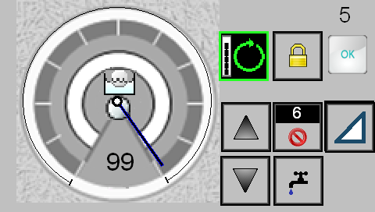
Water at max
Water control is at max trim setting.
Same critiques as the sweep screen… centering, button alignment / sizes, decrease dial size, background, etc.
Notes:
Water setting is at maximum trim value. Note the RUN control is turned on, this change is not sent to PLC until RUN control is tapped.

Slide 13
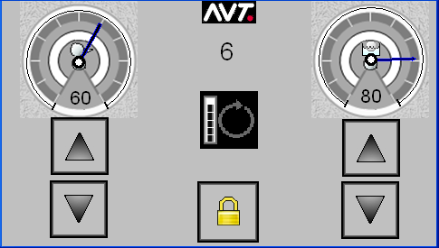
Another fountain
HMI software is configurable. This another fountain with different settings.

Slide 14
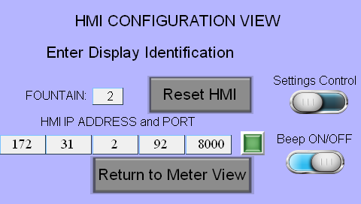
Configuration view
Here is the configuration view:
Notes:
Each HMI display can be setup for any fountain on the Mercury system.
The fountain setting here is 1 to x number of fountains on the press.
The HMI IP Address is displayed here to help change the IP address on this device.
After change the configuration of the HMI, it is best to reset the HMI to load the PLC limits and current settings into the HMI memory.
The Return to Meter View button is return to the Main View without changing anything.
The Settings Control setting is enable/disable the HMI factory settings control on the HMI display, in the lower right corner. It is best this control not be available to press operators.
The Beep ON/OFF controls the noise from the display’s keypad when each key is touched on the keypad.

Slide 15
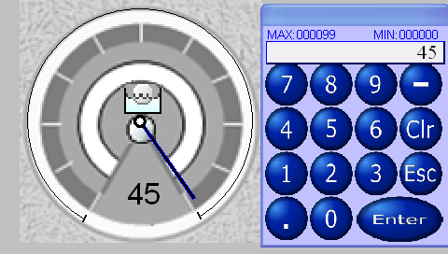
Direct entry of sweep/water trim
Keypad is available for direct entry of trim settings:
Notes:
Tapping the display at the trim value will make the keypad up. This allows the operator to directly enter the trim value in the PLC setting.
The ENTER button will complete this entry and make the keypad hide. The CLR button will erase the current digits, The ESC button will cancel any change made, making any change made in the keypad to be removed and the keypad will hide. The top of the keypad shows the minimum and maximum values possible to enter.

Slide 16
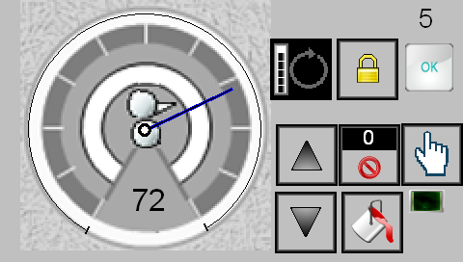
Controls named
1st row: digit in corner is fountain number.
2nd row: RUN control to confirm, lock control, OK returns to main view.
3rd row: trim increase, surge timer and cancel, inker function control.
4th row: trim decrease, surge timer increase, wash up status.
Notes:
Inker sweep controls, minus the ductor control.
1st row: digit in corner is fountain number.
2nd row: RUN control to confirm changes, lock control, OK returns to main view.
3rd row: trim increase, surge timer and cancel, inker function status.
4th row: trim decrease, surge timer increase, wash up status (green when wash up state is on)

Slide 17
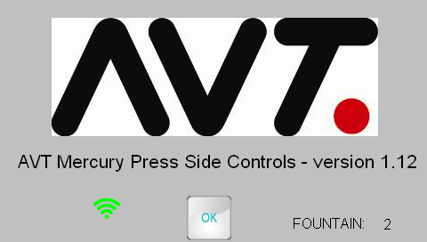
HMI startup screen
When the display is reset or powered on:
Notes:
When the HMI is first powered on or reset, this screen appears.
The AVT Logo is displayed, with name of product and software version.
Next is the PLC connection status and the fountain ID.
The OK button will continue to the display main view.

Slide 18
AVT PN and Development
TFS WI: 121438
Shipping PN:
Part #090G900342 ASSY, HMI MERC PU REMOTE
Replacement assy:
Part #050G400272 DISPLAY, HMI TCH 4.3" 24VDC
Part #067E370100-EN SFWR, HMI MERC PU REMOTE V1.00

